Slide 1

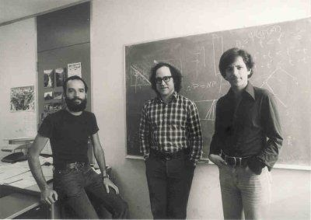
Rivest-Shamir-Adleman (RSA) Algorithm
Presented By: Rohan Sikder & Ronan Noonan

Slide 2
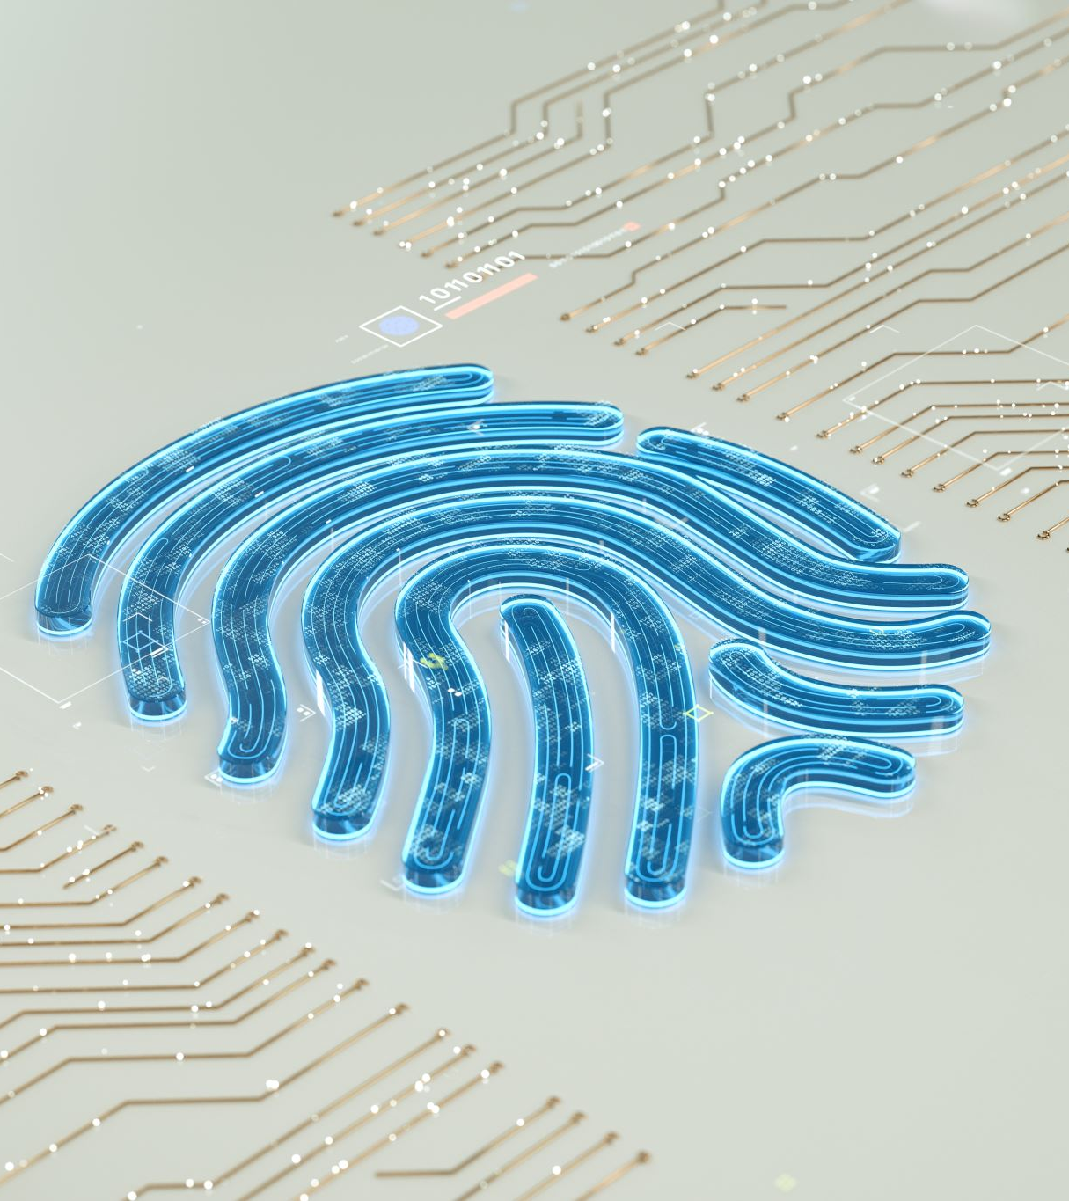
Introduction
RSA Creators: The Brilliant Trio - Rivest, Shamir, and Adleman
RSA – A Breakthrough in Cryptography
RSA transformed digital security.
Global Impact on Digital Security
Essential for Modern Encryption
Turing Award 2002: A Milestone for Cryptography

Slide 3
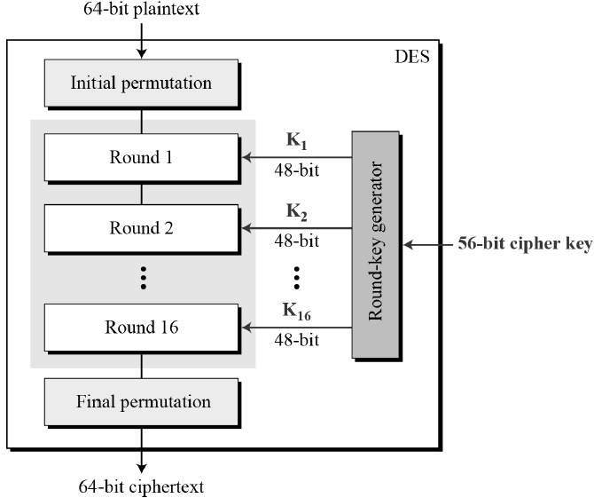
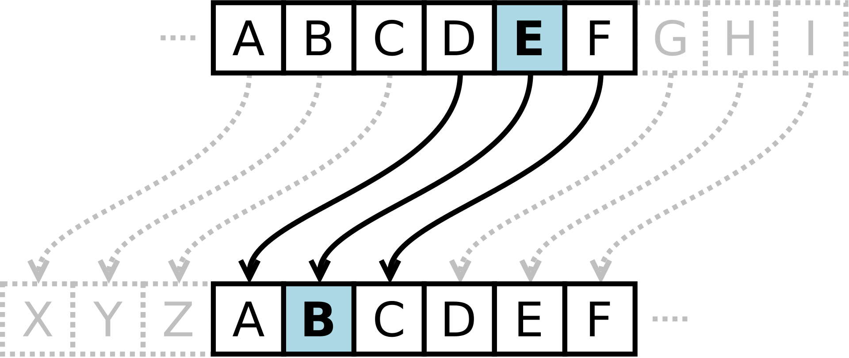
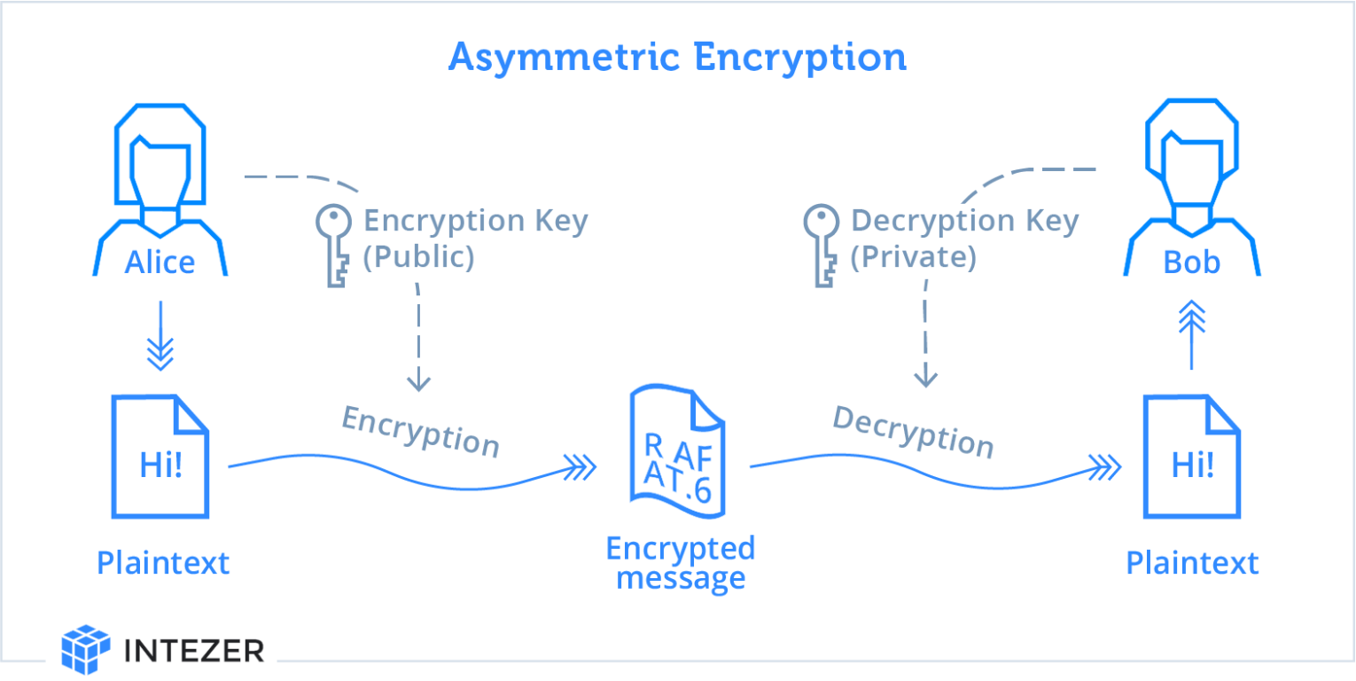
Background
Public-Key Cryptography: A Paradigm Shift
Symmetric–Key Cryptography But distribution of keys?
1970s – Diffie Helmen and Martin Hellman
RSA Algorithm – Public Key Cryptography
From Ancient Scripts to Digital Encryption
Caesars Ciphers – Roman Military
Traditional methods not effective
More Secure encryption needed
Data Encryption Standard (DES)
1970s Standardization: National Institute of Standards and Technology (NIST)
56-bit Key
DES’s Security - Brute-force attacks more feasible

Slide 4

Impact and Significance
Foundation for Digital Economy
Trust in Digital Infrastructure
Enabling Secure Digital Identities
Cultural Shift Toward Privacy

Slide 5
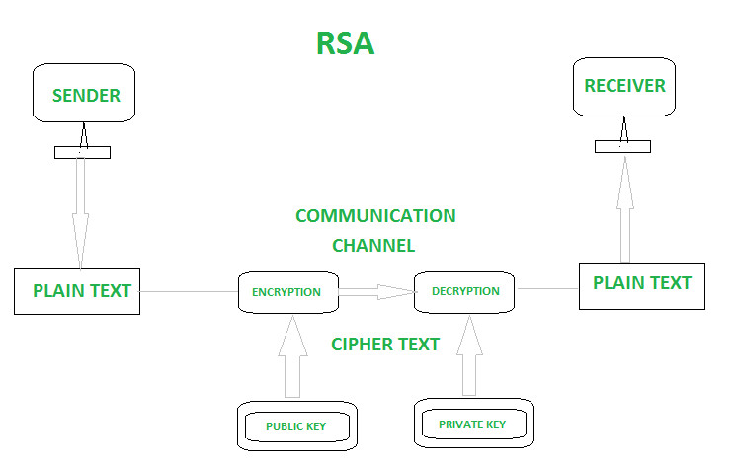
RSA Algorithm
Basics of RSA Algorithm:
Steps:
Public and Private Key Generation:
Encryption and Decryption Process:
Security Based on Computational Difficulty:
Applications in Digital Security:
Two Prime Numbers
Public and Private Key
Ciphertext
Factoring Number to Prime Numbers
Key Length (1024, 2048, and 3072 bits)
SSL/TLS handshake

Slide 6
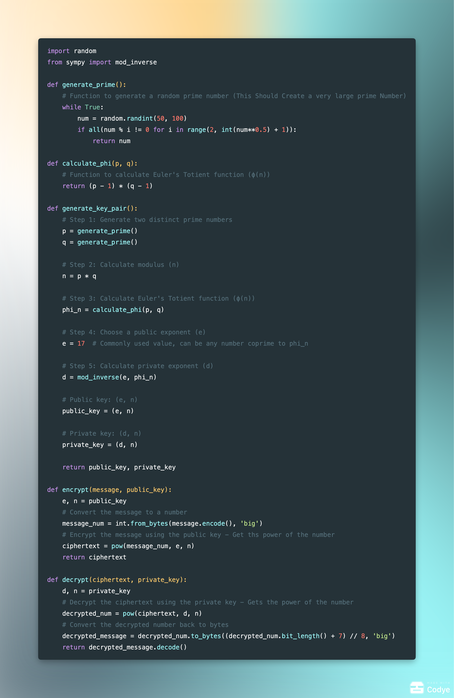
RSA Python Implementation

Slide 7
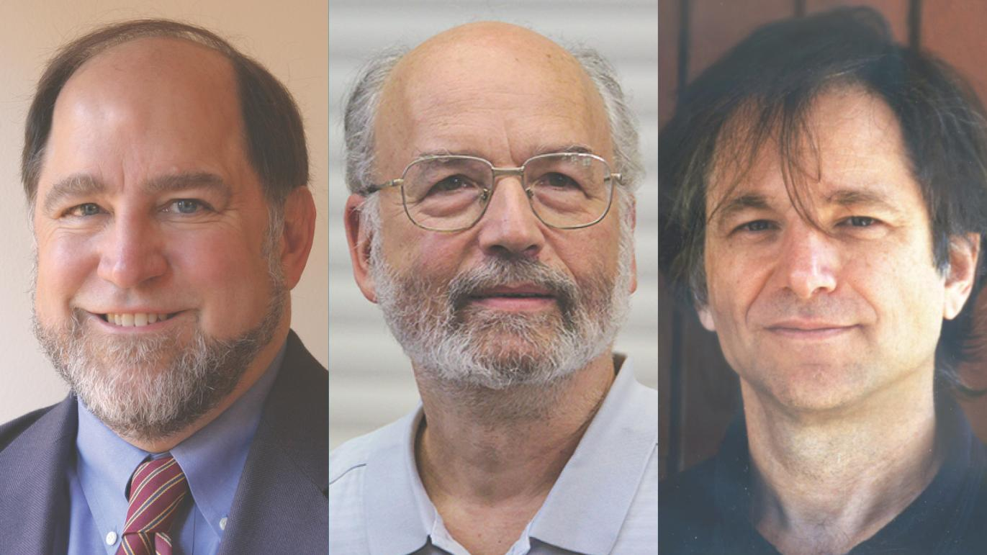
Biographical Information
Ron Rivest - MIT professor and algorithmic expert, instrumental in developing RSA and election security.
Adi Shamir - Turing Award-winning Israeli cryptographer and Weizmann Institute professor, co-inventor of RSA.
Leonard Adleman - USC professor, pioneer in theoretical computer science and DNA computing, RSA co-inventor.

Slide 8
Turing Award Recognition
The Turing Award: Computing's Highest Honor
The Trio's Achievement: Setting Cryptography Milestones
RSA's Broader Impact: From Theory to Practice

Slide 9
Future of Cryptography
Quantum Computing: A Challenge to Current Standards
The Quest for Quantum-Resistant Algorithms
Challenges in Implementation and Adoption

Slide 10
Conclusion
RSA's Central Role in Communication Security
Rivest, Shamir’s, Adleman Enduring Legacy
The Future of Cryptography: Adapting to New Challenges

Slide 11

Questions?

